Slide 1
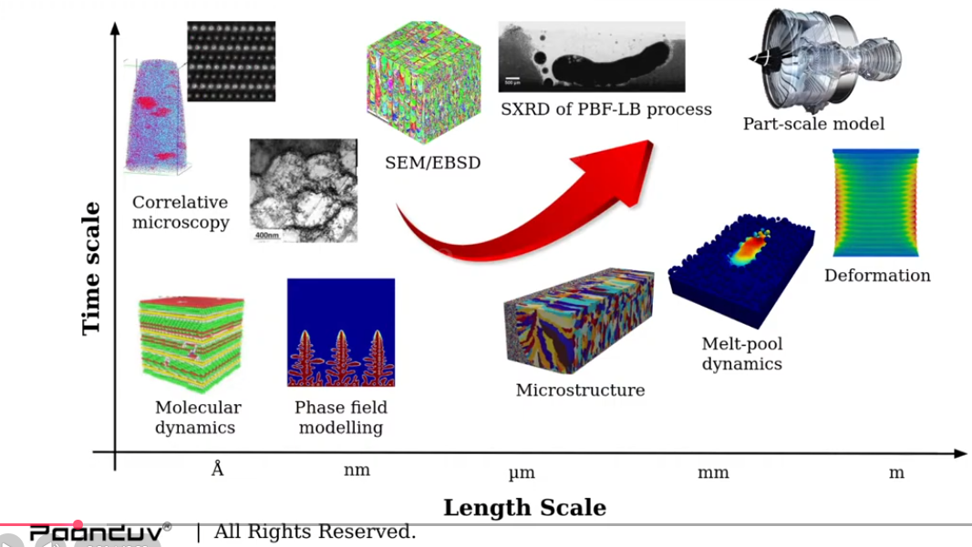

Paanduv
Applications
AM PravaH®
Focus
https://www.youtube.com/live/J4ieku-yXrY
Physical experiments as an alternative to modelling:
X-ray diffraction (XRD) methods are analytical techniques used to determine the atomic and molecular structure, crystal phases, and spacing of crystalline materials
“Simulating process … helps you to understand what kind of parameters and process you have to optimize in order to attain the final product you are design”
Rodrigo M Grossi – grossirm@hotmail.com

Slide 2

CFD
https://github.com/DLR-RY/VoFLibrary
Volume of fluid method
Laser heat input … latent input
Surface tension
Marangoni force
“This gives you the basis of how the simulation solver is modelled and how we can rely on the data that has been predicted … based on this robust physic equations that are provided”

Slide 3
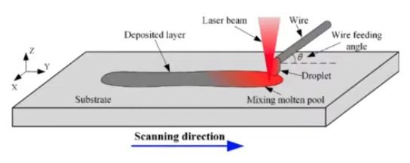

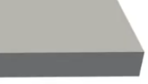




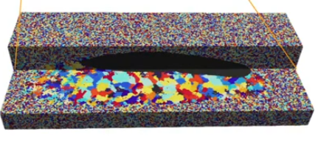
Identification of straitening mechanisms!
CFD
Melt poll
Multiphysics melt poll dynamics
Marangoni convections
Energy transference (enough to fuse with the substrate!)
Subsequent microstructure analysis …
+ CFD
Monte Carlo Potts model, spins
Fusion of the layer that has been deposited with the substrate and subsequent cooling …
epitaxial grain growth

Slide 4
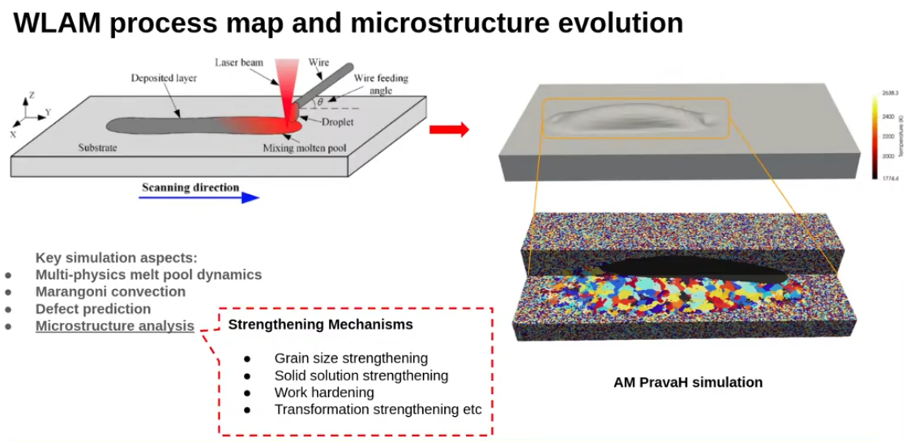
Increase control of microstructure
Focus
Grain size control | solid solution straitening | intermetallic compounds | precipitations | deformation
Grain size straitening

Slide 5

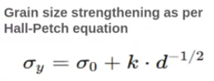
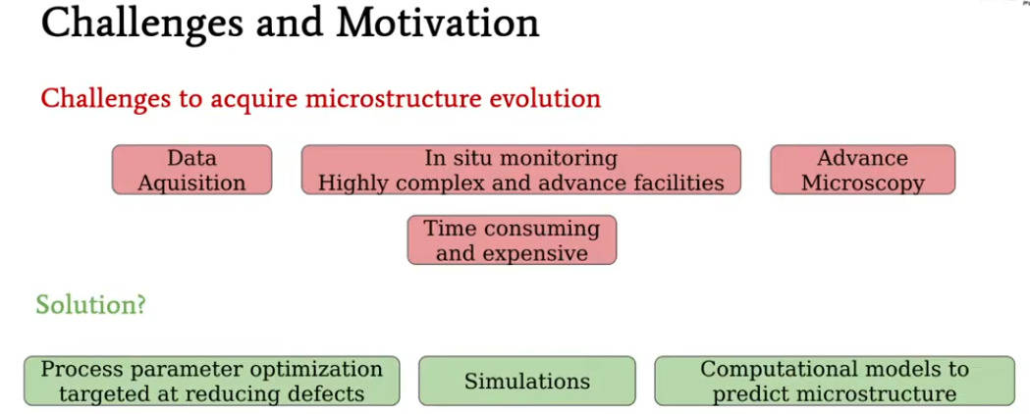
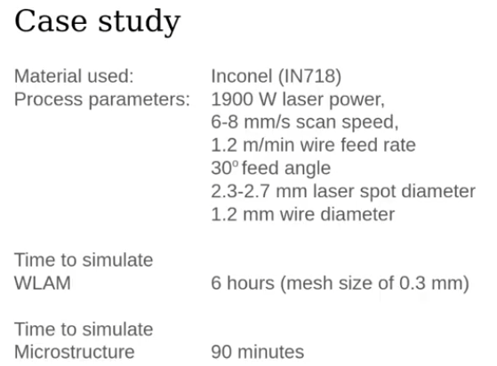
Grain nucleation, growth and grain size evolution predicted via
Monte Carlo Potts modelling
https://www.sciencedirect.com/science/article/pii/S0264127522010620
A full-scale Monte Carlo Potts model and real time conversion under non-uniform temperature distribution
Hall-petch equation
microstructure
Phace changes …. CFD | … to Monte Carlo (grain growth) … microstructure (temperatures .. )
Grain nucleation, growth, size evolution
The straitening is inversely proportional to the grain size
microstructure prediction
12:25

Slide 6
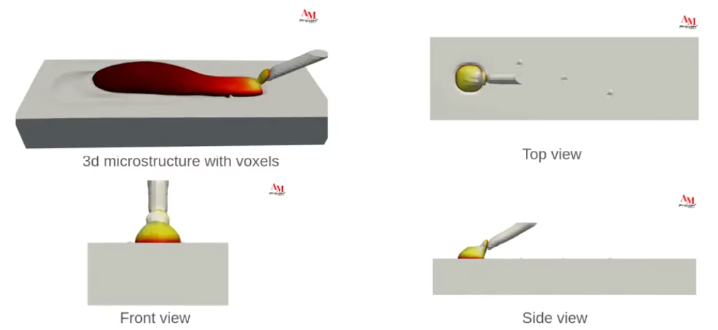
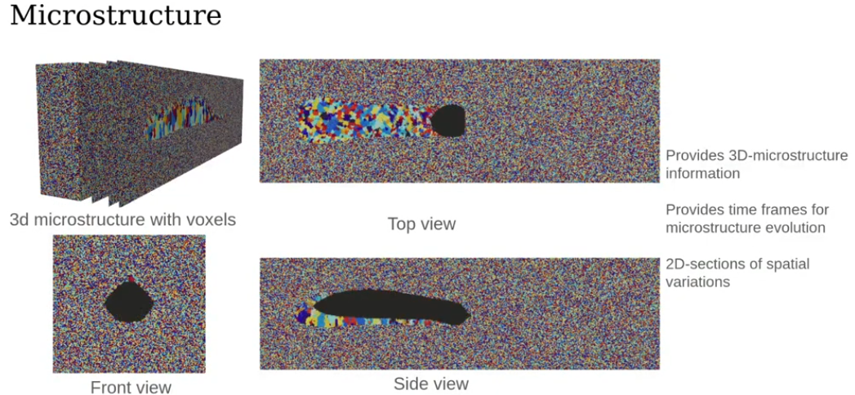
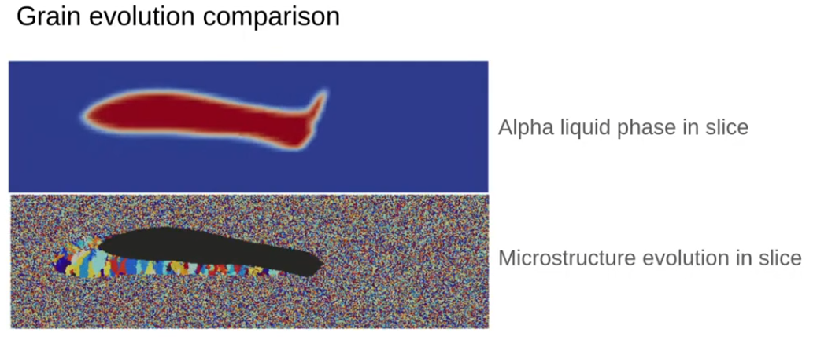
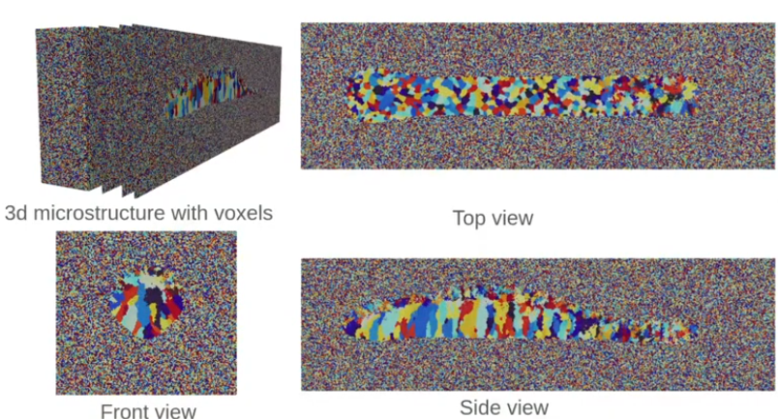

Slide 7
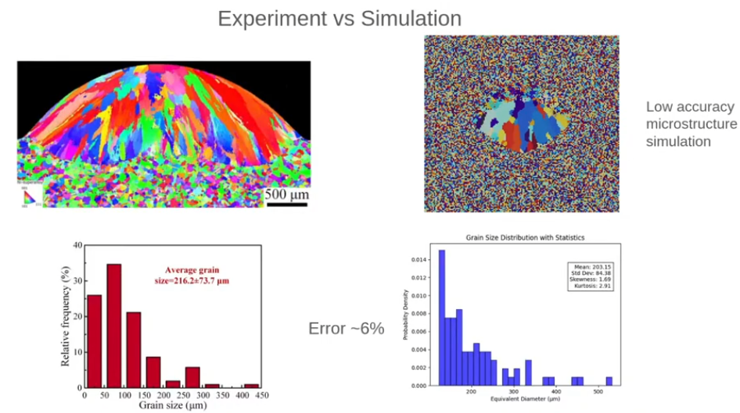
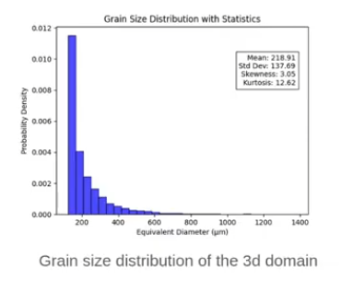
epidexial grain growth

Slide 8
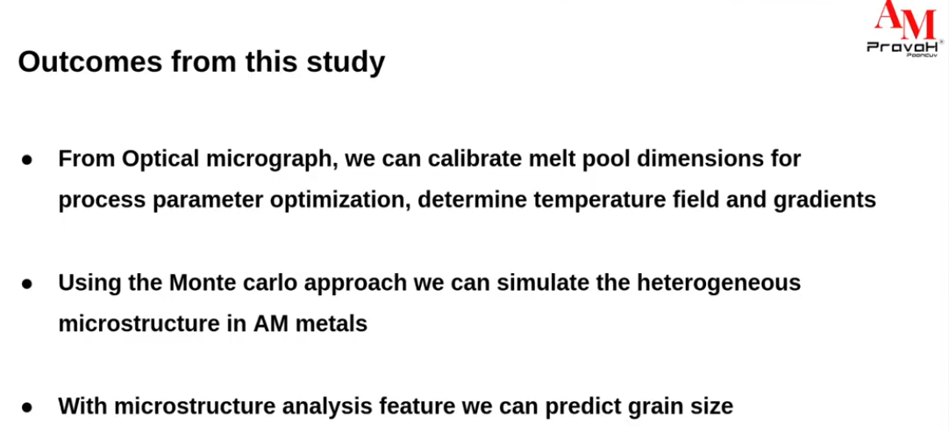
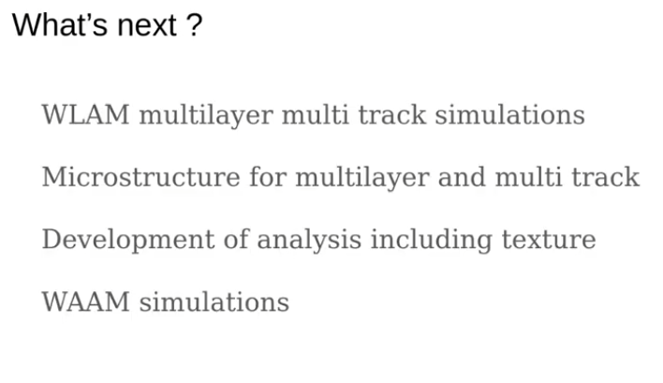
Process parameter optimization
Uniform and defect free tracks
Design of experiments
Wire Laser Additive Manufacturing (WLAM)
"cutting the lab work and analysis using microstructure“
… LPBF - Laser Powder Bed Fusion
VAM - Volumetric Additive Manufacturing

